Slide 1
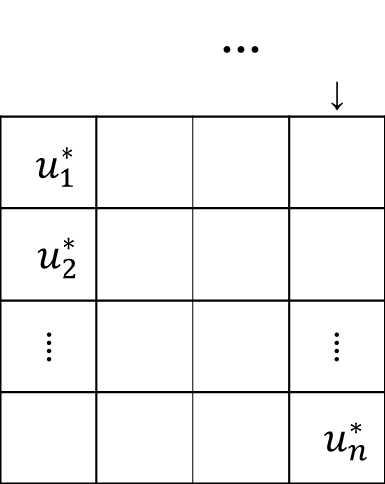

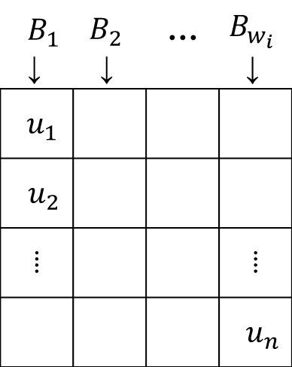



$$B_{1}$$ ↓ | $$B_{2}$$ ↓ | … | $$B_{w_{i}}$$ ↓
$$u_{1}$$
$$u_{2}$$
⁞ |  |  | ⁞
 |  |  | $$u_{n}$$
$$B_{w_{i}c\log{n}}$$
 |  | … | ↓
$$u_{1}^{∗}$$
$$u_{2}^{∗}$$
⁞ |  |  | ⁞
 |  |  | $$u_{n}^{∗}$$
$$\frac{n}{w_{i}}$$
…
$$w_{i}$$
$$c\log{n}$$

